Slide 1
张吉祺
01
Camera Roaming
02
Sky box
03
Display Text
04
Anti-Aliasing
05
Lens Flare

Slide 2
Lens Flare
Lens flare is caused by light passing through a photographic lens system in an unintended way. Often considered a degrading artifact, it has become a crucial component for realistic imagery and an artistic means that can even lead to an increased perceived brightness.

Slide 3
Lens Flare
Common
technique

Slide 4
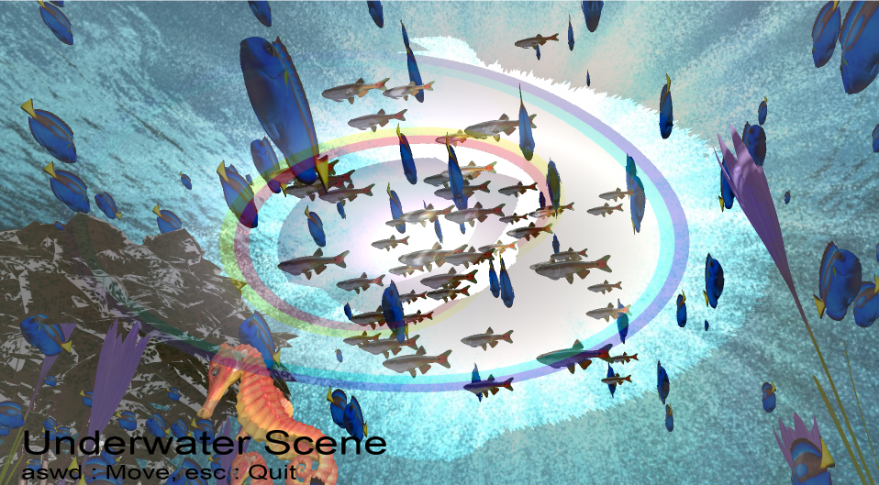
Lens Flare

Slide 5
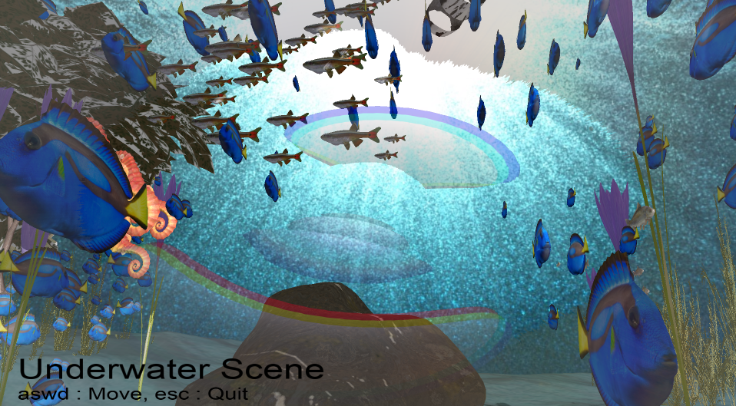
Lens Flare

Slide 6
Lens Flare
The approach consists of 4 stages:
01
Downsample/Threshold
02
Feature Generation
03
Blur
04
Upscale/Blend

Slide 7
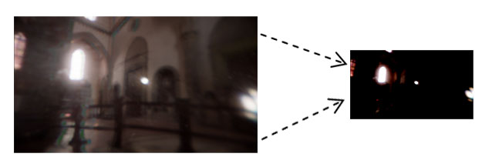
Downsample/Threshold
Select a subset of the brightest pixels in the source image
Key to reducing the cost of subsequent stage

Slide 8
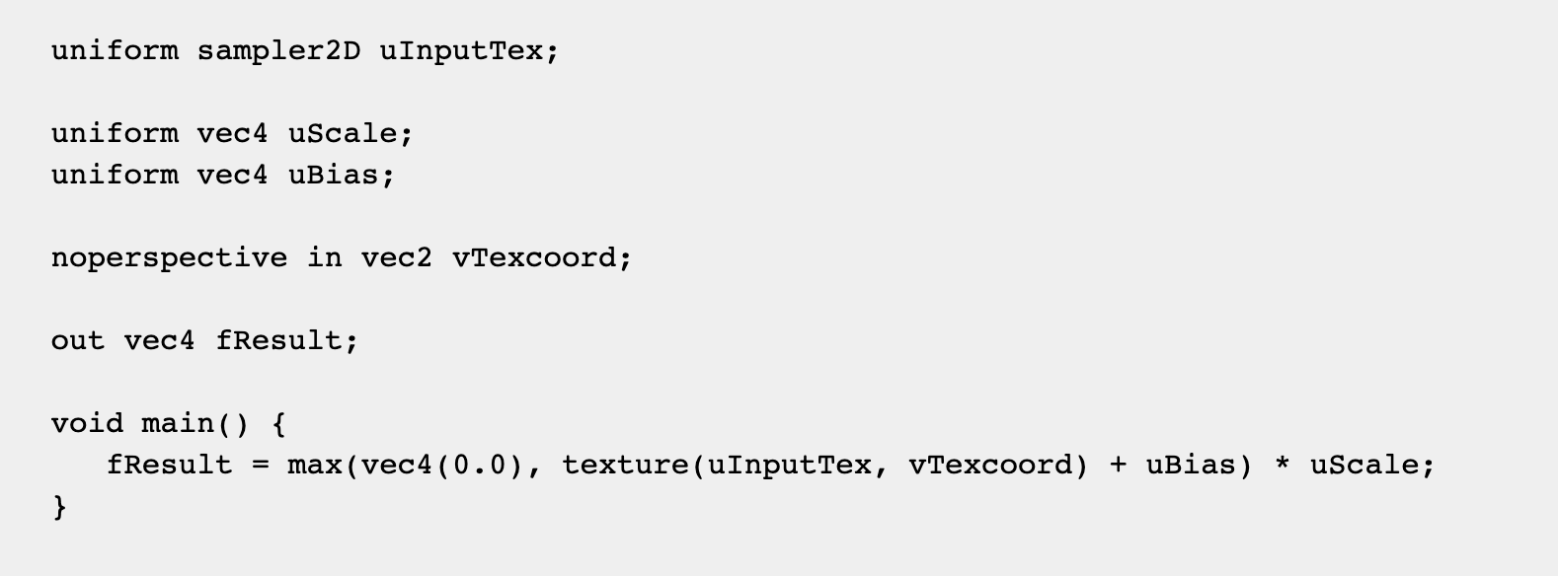
Downsample/Threshold

Slide 9
Feature Generation
01
Ghosts
02
Halos
03
Chromatic Distortion

Slide 10
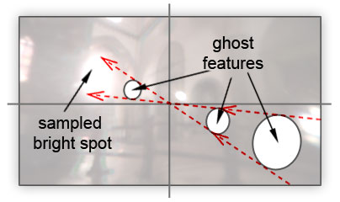
Ghosts
The repetitious blobs which mirror bright spots in the input, pivoting around the image centre

Slide 11
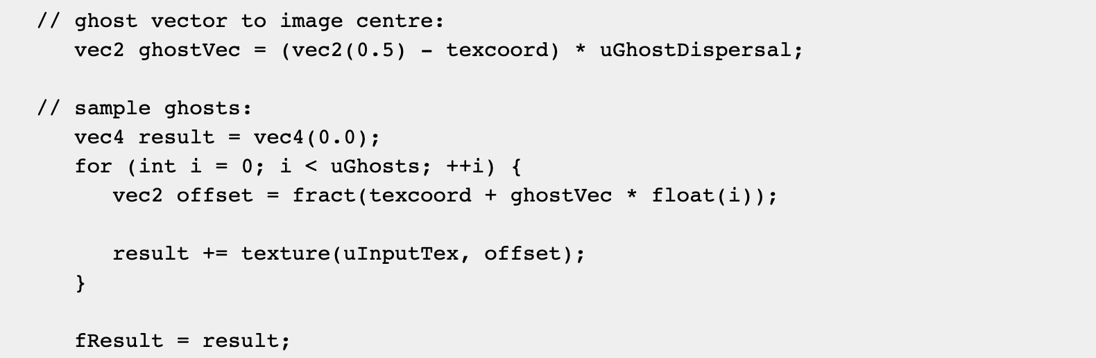
Ghosts

Slide 12
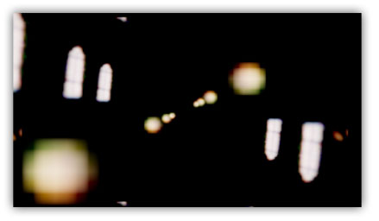
Ghosts

Slide 13
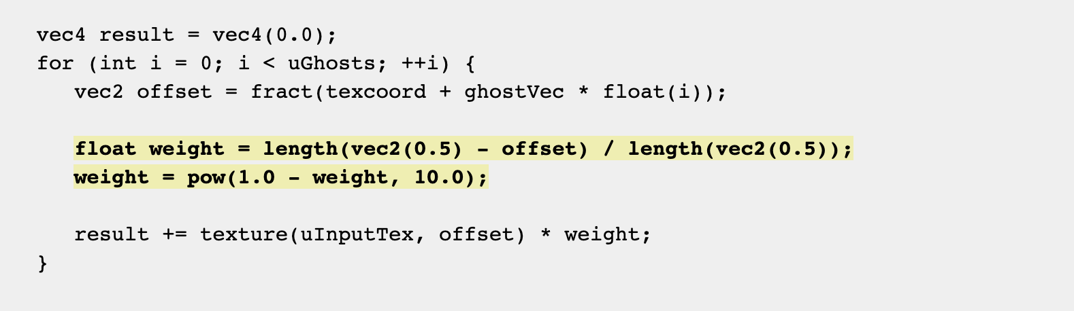
Ghosts
Improve this by allowing only bright spots from the centre of the source image to generate ghosts by weighting samples by a falloff from the image centre

Slide 14
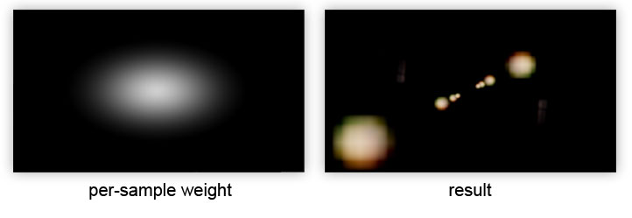
Ghosts

Slide 15

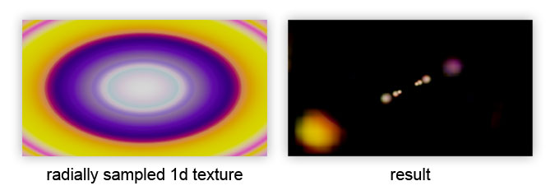
Ghosts
Modulating the ghost colour radially according to a 1D texture

Slide 16
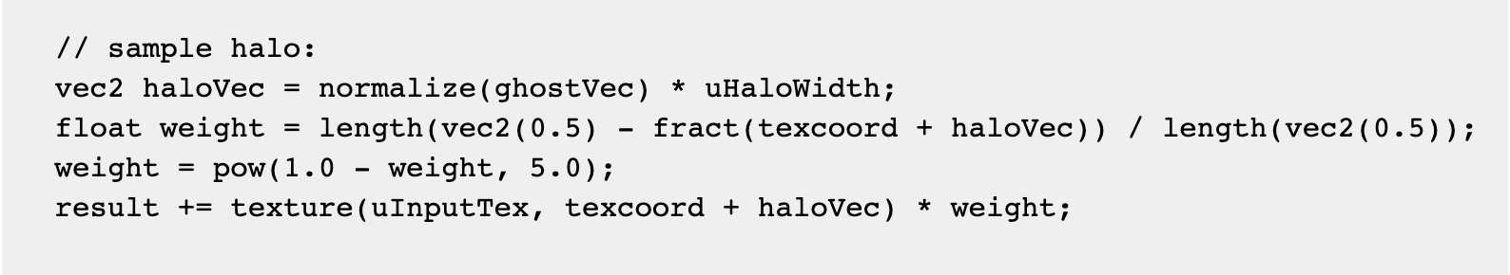
Halos
Take a vector to the centre of the image but fix the vector length

Slide 17
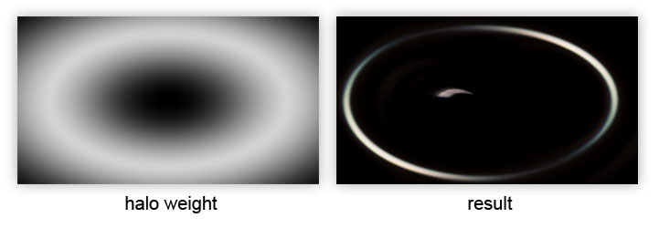
Halos

Slide 18
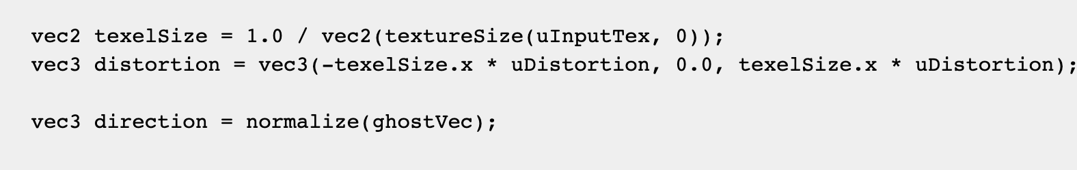
Chromatic Distortion
Caused by the varying refraction of different wavelengths of light
Fetch the red, green and blue channels separately at slightly different offsets along the sampling vector

Slide 19
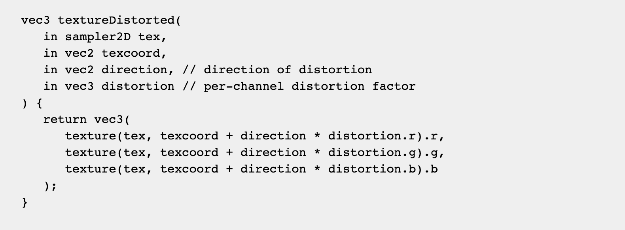
Chromatic Distortion
Direct replacement for the calls to texture()

Slide 20
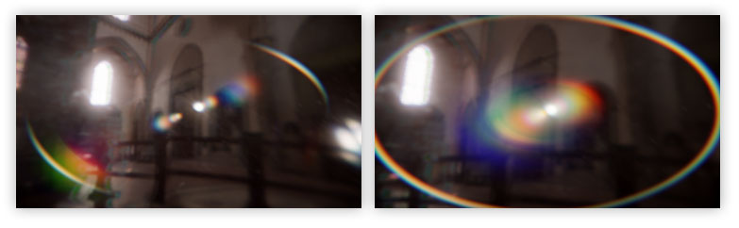
Chromatic Distortion

Slide 21
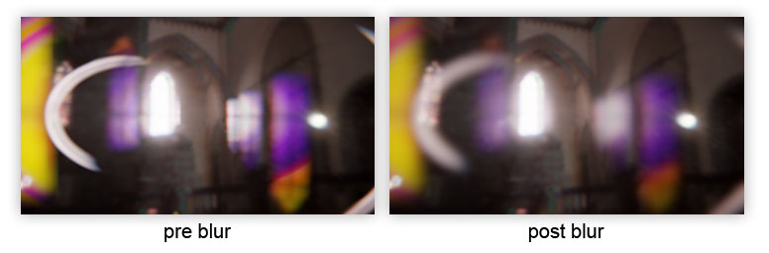
Blur
Reduce the coherence with the input image to enhance the effect

Slide 22
Upscale/Blend
Combine with the original source image:
01
Lens Dirt
02
Diffraction Starburst

Slide 23
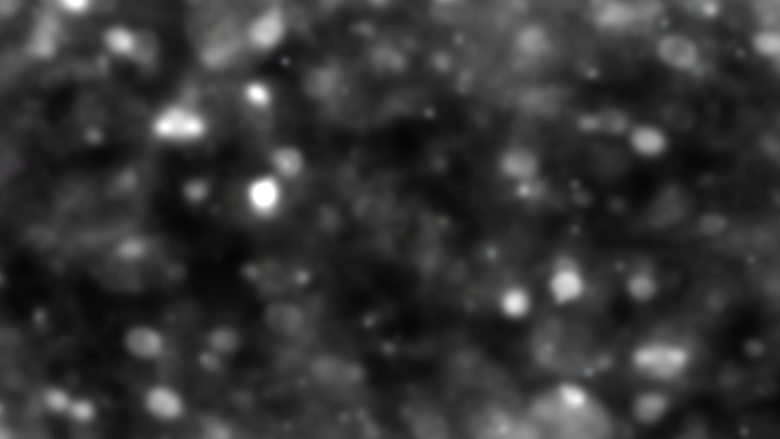
Lens Dirt

Slide 24
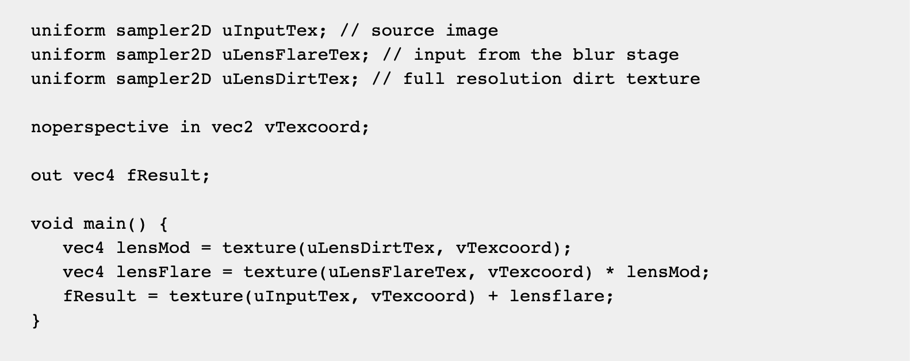
Lens Dirt

Slide 25
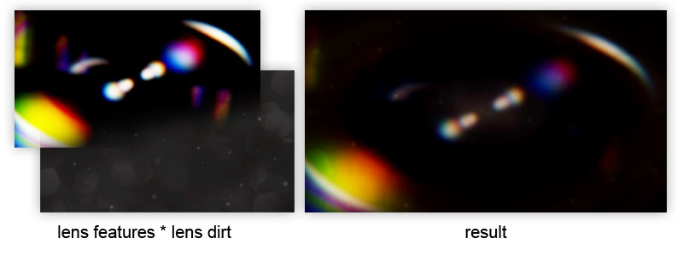
Lens Dirt

Slide 26
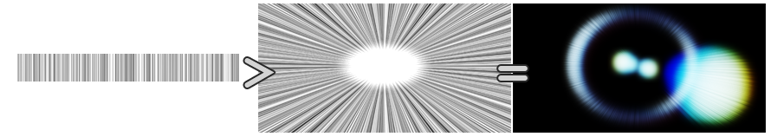
Diffraction Starburst

Slide 27
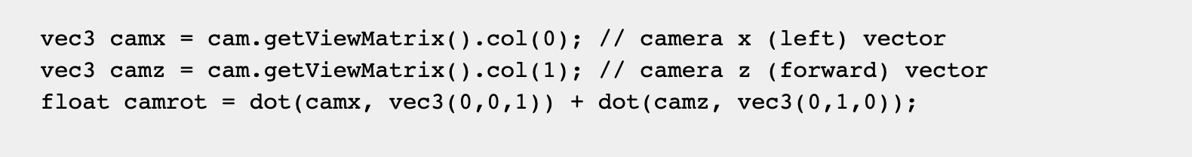
Diffraction Starburst
Provide a transformation matrix to spin/warp it per frame and produce the dynamic effect

Slide 28
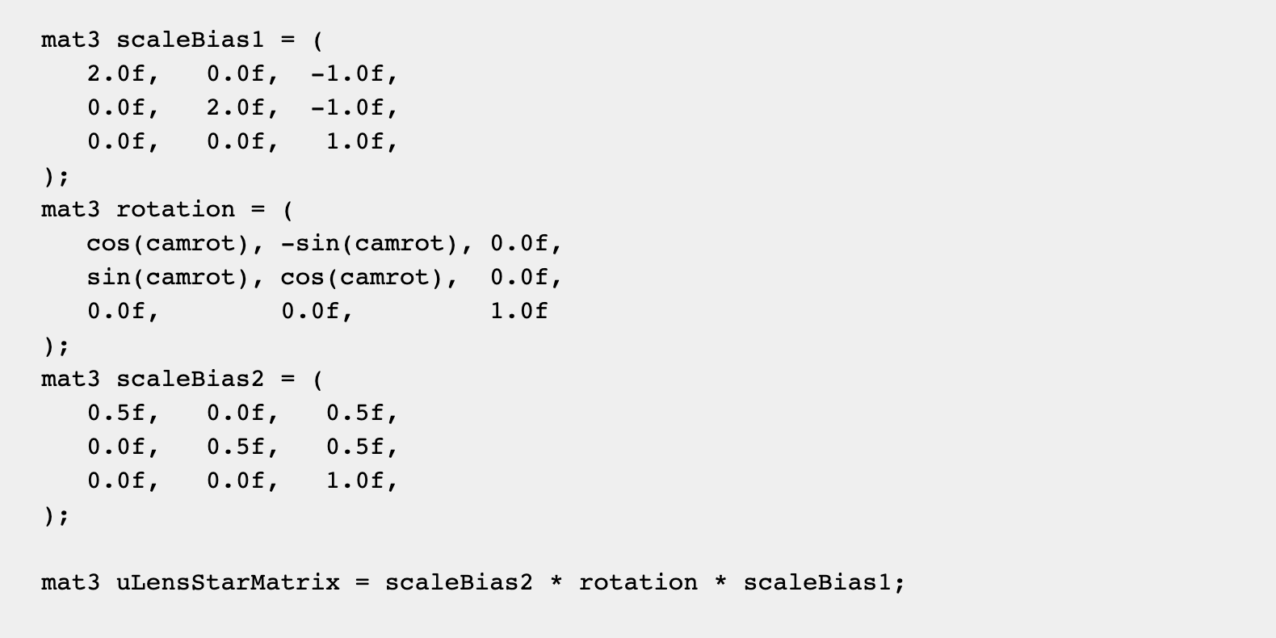
Diffraction Starburst

Slide 29
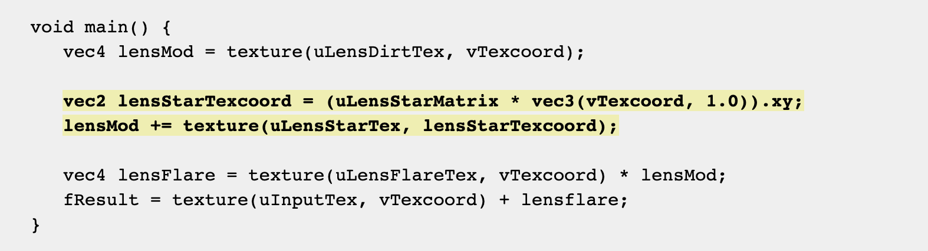
Diffraction Starburst

